Slide 1
Module 5: Principles of Data Ethics
Week 8

Slide 2
Overview
What is Data Ethics? And Digital Ethics?
Principles of Data Ethics
Why do we need data ethics?
Cyberbullying
Informational Privacy
Whistleblowing
Case Studies

Slide 3
Data Ethics and Digital Ethics
Ethics: Rules of conduct or societal norms with respect to a group or culture.
Morals: Behaviours with respect to what an individual believes is right or wrong.
Data Ethics: a branch or type of ethics that evaluates data practices like data collection, analysis and handling.
Digital Ethics: the branch of ethics that govern interpersonal behaviour between individuals and/or companies that is mediated by computer technology

Slide 4
Principles of Data Ethics
Several professional associations and private firms have formulated more specific principles to guide actions with respect to data and information technology.
The Singapore Computer Society’s professional Code of Conduct: Integrity and Professionalism

Slide 5
Principles of Data Ethics
EXERCISE 1:
Can any of the principles in the Singapore Computer Society (SCS) Code of Conduct be supported by utilitarianism? Describe one such principle and explain how utilitarianism supports it.
Can any of the principles in the SCS Code of Conduct be supported by virtue ethics? Describe one such principle and explain how virtue ethics supports it.
Can any of the principles in the SCS Code of Conduct be supported by Kant’s deontological ethics? Describe one such principle and explain how Kant’s ethics supports it

Slide 6
Utilitarianism
An ethical theory which states that the best action is the one that maximizes utility.
Utility as the sum of all happy satisfaction that results from an action, minimize the suffering of anyone involved in the action.
Utilitarianism – theory of ethics which states that a person’s act is morally right if and only if it produces at least as much happiness as any other act that the person could perform at that time.

Slide 7
Why do we need data/digital ethics?
Cyberbullying
Informational Privacy or Breach of personal information
Whistleblowing

Slide 8
Cyberbullying
Causing psychological harm to a person or group by using the digital tools or the internet.
Examples
Repeatedly texting or emailing hurtful messages to another person.
Spreading derogatory lies about another person.
Tricking someone into revealing highly personal information.
“Outing” or revealing someone’s secrets online.
Posting embarrassing photographs or videos of other people without their consent.
Impersonating someone else online in order to damage that person’s reputation.
Threatening or creating significant fear in another person
Effects (short/long-term)?
Actions to take as a victims to cyberbullying or as a bystander/friend to a victim?

Slide 9
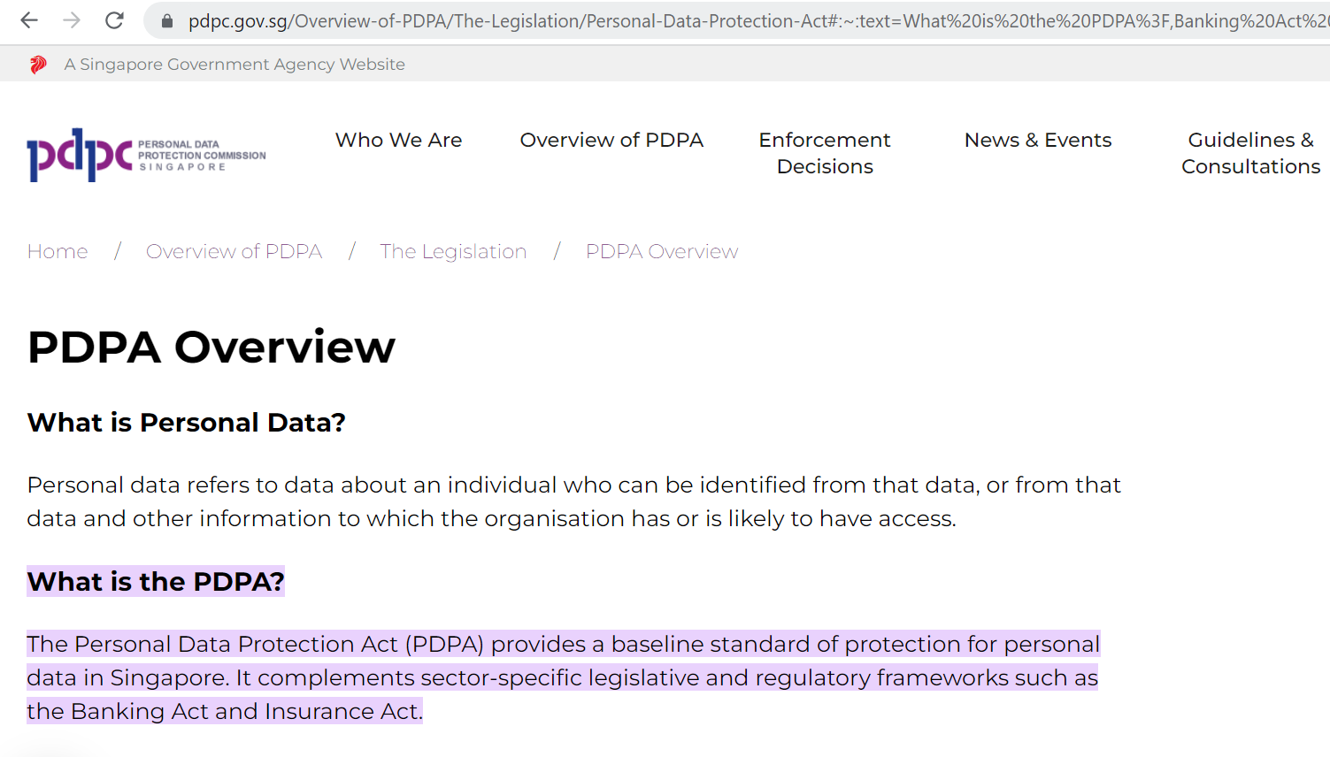
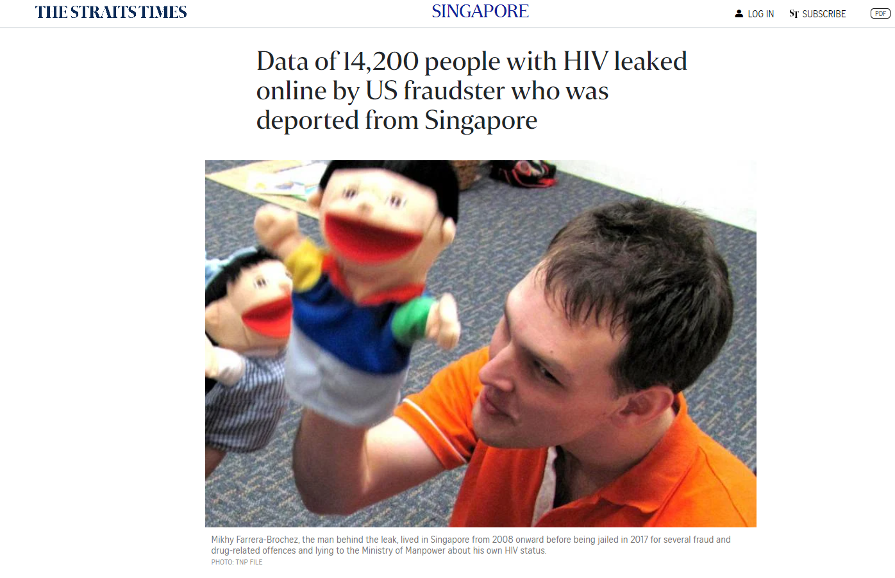
Informational Privacy
Digital and online technologies affect informational privacy: confidentiality, anonymity, data protection and secrecy of facts about persons.
What’s so bad about not having informational privacy?
What negative outcomes could befall someone who loses informational privacy

Slide 10
Whistleblowing
There are many examples of misconduct in organisations not being brought to light until much damage has already been done, or only after a private citizen reported it at great personal cost.
Sometimes it is up to ordinary, low-level people to “blow the whistle” on unacceptable conduct in their organisations.
“A whistle-blower is someone who breaks ranks with an organization in order to make an unauthorized disclosure of information about a harmful situation after attempts to report the concerns through authorized organizational channels have been ignored or rebuffed.”

Slide 11
When should one whistle-blow?
Richard T. De George proposed that whistle-blowing is morally permissible when three conditions are fulfilled
The firm...will do [or has done] serious and considerable harm to employees or to the public;
Once employees identify a serious threat to the user of a product or to the general public, they should report it to their immediate superior and make their moral concern known;
If one's immediate supervisor does nothing effective about the concern or complaint, the employee should exhaust the internal procedures and possibilities within the firm

Slide 12
When should one whistle-blow?
De George went on to suggest that if two additional conditions are met, then it would be morally obligatory for someone to whistle-blow
The whistle‐blower must have, or have accessible, documented evidence that would convince a reasonable, impartial observer that one's view of the situation is correct; and
The employee must have good reasons to believe that by going public the necessary changes will be brought about. The chance of being successful must be worth the risk one takes and the danger to which one is exposed.

Slide 13
Tutorial Activities
Lesson Overview
In this week module 5 activities, the students will learn the importance of appropriate behaviours on digital platforms, upholding ethics while handling personal information and whistleblowing for unethical/illegal acts. Upon completion of the lesson, students will be able to understand the importance digital wellbeing and ethics awareness.
Activity 1: Importance of appropriate behaviours on digital platforms to avoid cyberbullying.
Activity 2: Importance of upholding ethics while handling personal information (Informational Privacy).
Activity 3: Importance of whistleblowing for unethical/illegal acts.

